Slide 1
Detection of AI generated text using LLMs
By Varun Ramanathan, Hannah Mariam John (21BAI1577, 21BAI1381)

Slide 2
Introduction
Advent of Advanced AI Chatbots
Why detect AI-generated text?
Academic integrity
Creative Fields
Fake news and propaganda

Slide 3
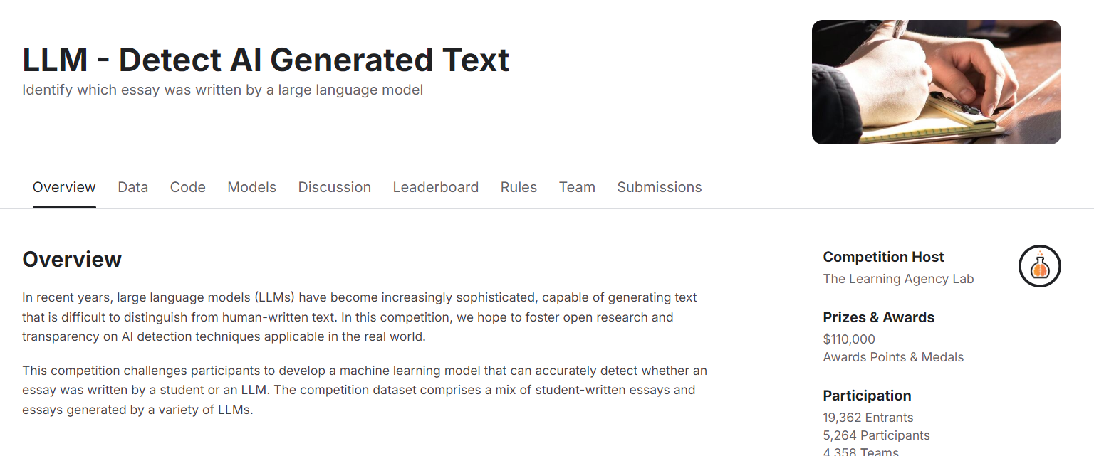
Dataset Overview

Slide 4
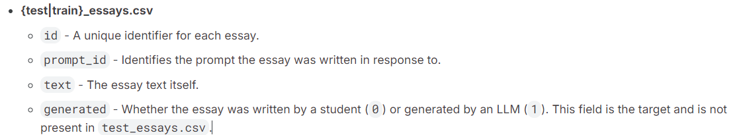
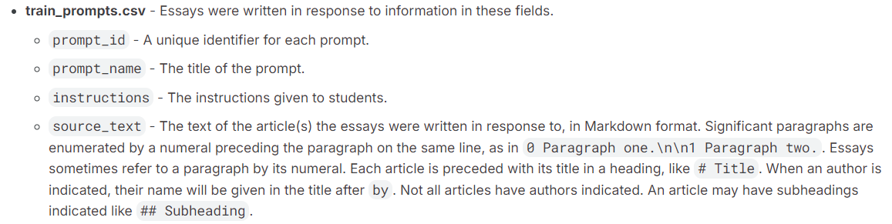
File and Field Information

Slide 5
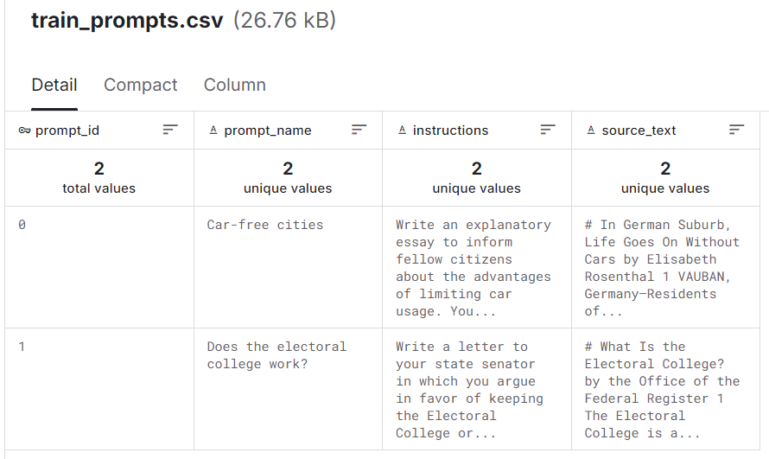

Slide 6
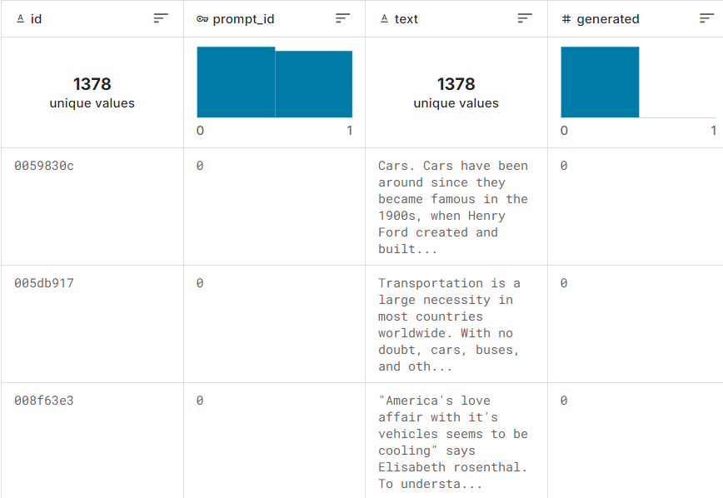

Slide 7

Develop a machine learning model that can accurately detect whether an essay was written by a student or an LLM.
The competition dataset comprises a mix of student-written essays and essays generated by a variety of LLMs.
Notes:
Must not have a GPU enabled. The Efficiency Prize is CPU Only.

Slide 8
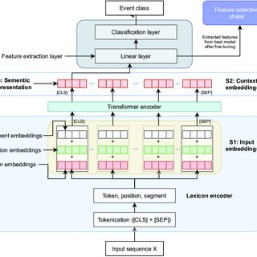
Methodology
distilbert-base-uncased
smaller and faster version of BERT
The distilbert-base-uncased backbone is frozen
A classification head(dense,dropout,output projection layers) is added on top of DistilBERT to map output embeddings to label classes

Slide 9
Challenges in Detecting AI-Generated Text
Similarities between AI and human text.
Handling edge cases (e.g., creative, unusual human writing).
Model limitations (biases, false positives, and negatives).

Slide 10
Evaluation Metrics
Accuracy
Precision
Recall
F1-score
Confusion matrix

